Slide 1

VOLTORB MAY
2021
This is really going to be lit.

Slide 2
PROBLEM STATEMENT - 1
Impetus is about to happen soon. The whole college is bustling with activity, but someone has misplaced the decorative lights. It is now your job to make led lights blink.
Instructions:
Use of Microcontroller is NOT allowed.
The LED should be ON for 1second, OFF for 1second, then again ON for 1second and so on until the circuit is powered.

Slide 3
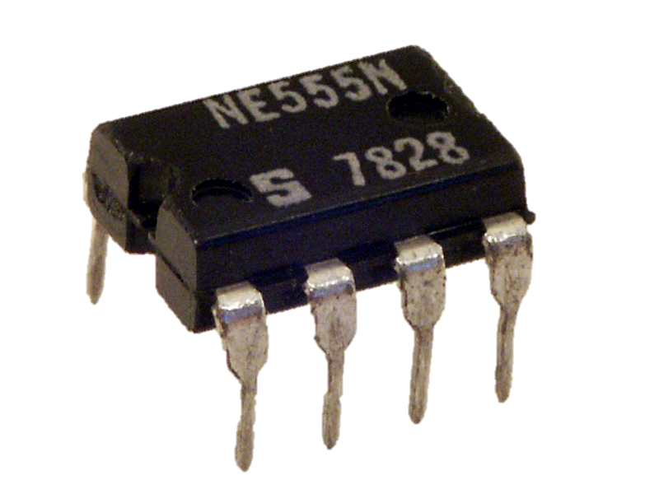
555 timer to the rescue!
Now we know that the 555 timer IC can be
operated in 3 different modes: astable, monostable
and bistable.
To get an LED to blink i.e. turn ON and OFF with the given duty cycle, we need to operate the IC in astable mode. The output in this case will be a square wave.
As per the given instructions, the ON time is equal to the OFF time. Hence, the duty cycle is 50%. We need to design the circuit accordingly. Connecting the LED to the output pin of the IC through a resistor will make our LED blink as needed.

Slide 4
PROBLEM STATEMENT - 2
Harshad Mehta is a busy man, and has no time to look into the lighting system of his house. Help him out and build a system that can:
Check if the lights are on.
Check if any person is present. If person is there and lights are off, the lights should be turned on. If there is no one and the lights are on, they should be turned off.
The condition of the lights (whether ON or OFF) should be displayed in any way you choose. Use of microcontroller is allowed.

Slide 5
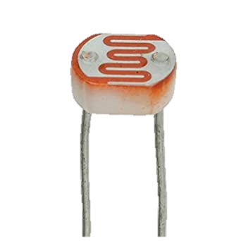
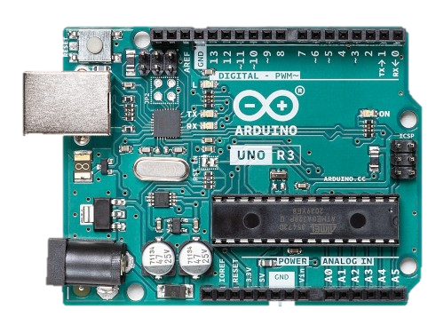
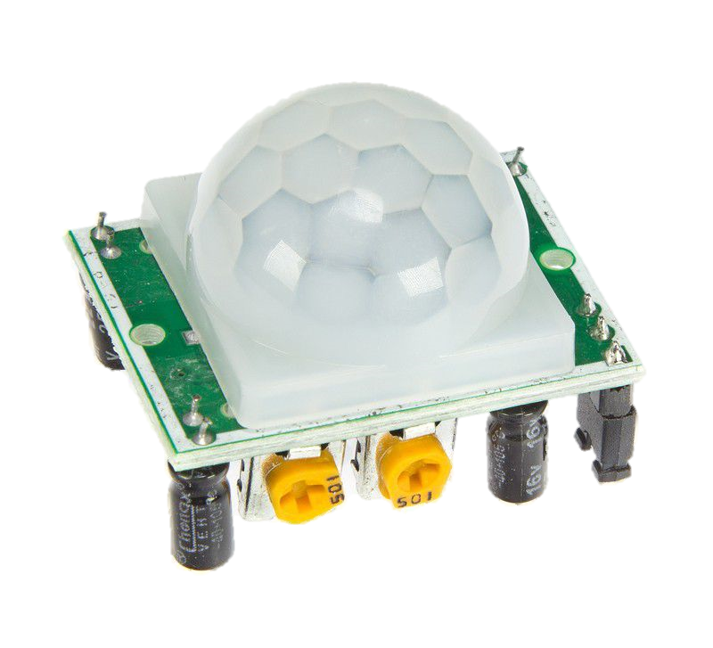
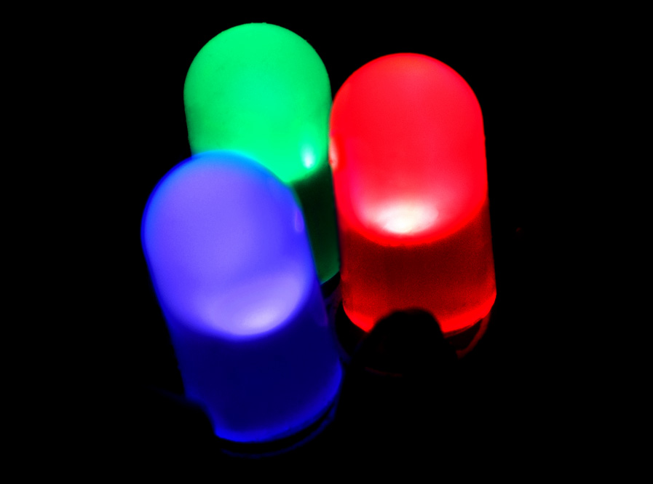
PIR sensor
Microcontroller
LDR
Passive Infrared sensor to check if there is a person or not.
INPUT
INPUT
OUTPUT
Light Dependent Resistor to check whether the lights are already on.

Slide 6
How does it function?
01.
First, the input from LDR is checked.
02.
Then, the input from PIR is checked.
03.
Based on the inputs from the sensors, the output of the lights is set for each condition.

Slide 7

This picture came with the template and looked relevant.

Slide 8
THANK YOU!
- TEAM IEEE UVCE PES

